Slide 1
Game Programming Workshop
Zoe Rowbotham & Tom Hudson

Slide 2
About Ourselves and the Games Industry

Slide 3
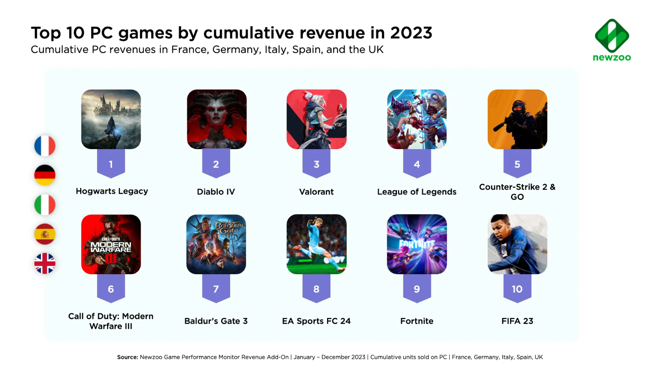

Slide 5
Games Industry Disciplines
AUDIO
DESIGN
CODE
QA
ART
PRODUCTION

Slide 6





Slide 7
Zoe’s Journey
01
02
03
04
05
Computing GCSE and A Level
Games Technology Degree at University
Undergraduate Work Placement at Sumo Leamington
Graduated with a 1st Class Honors
Began as a Junior Programmer at Sumo Leamington

Slide 8
Tom’s Journey
01
02
03
04
05
No Computing GCSE or A Level (was not given the opportunity)
Worked in retail (GAME) for 2 Years
Found a degree that didn’t require Computing and
graduated with a 1st Class Honors
Joined Kwalee as a Junior Programmer (first industry role)
Moved to Sumo Leamington

Slide 9
Workshop Time!

Slide 10

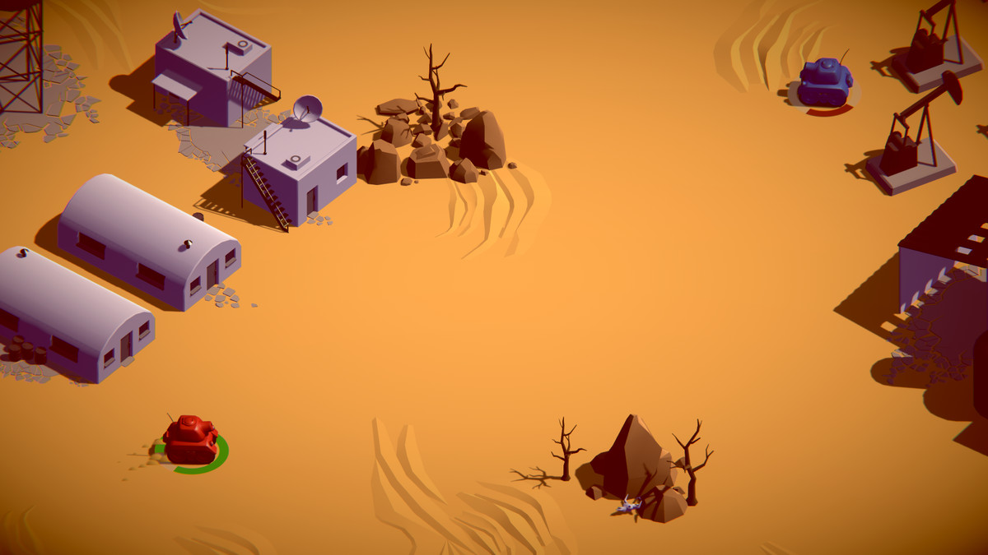
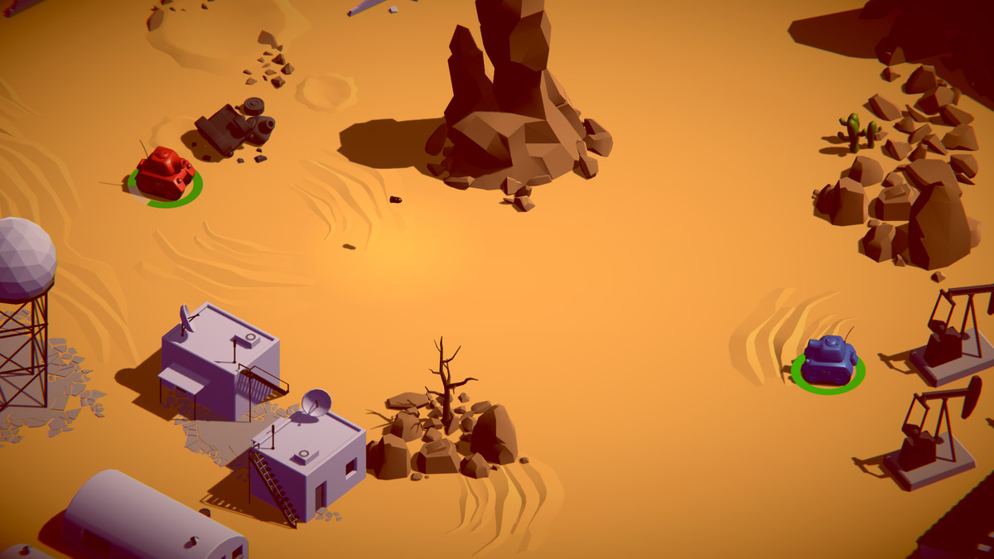
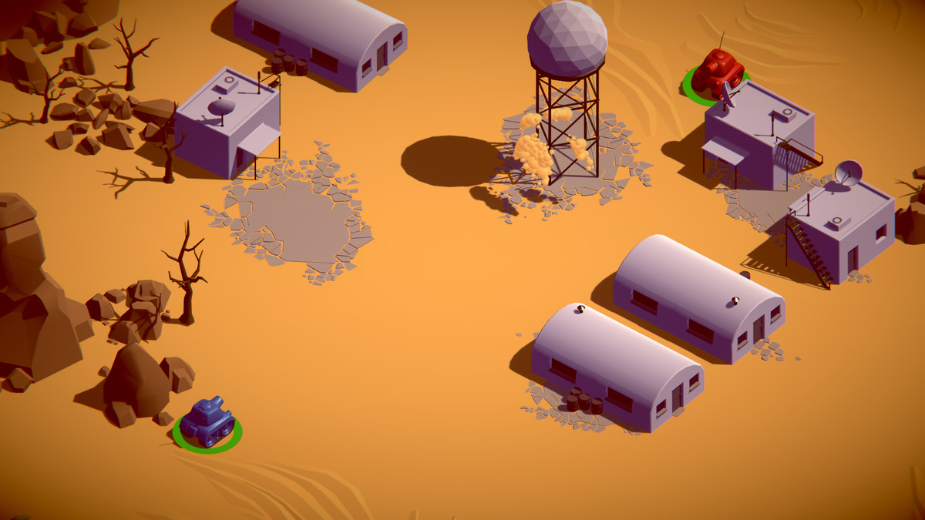
Aim Of The Workshop

Slide 11
01
Introduction to Unity

Slide 12
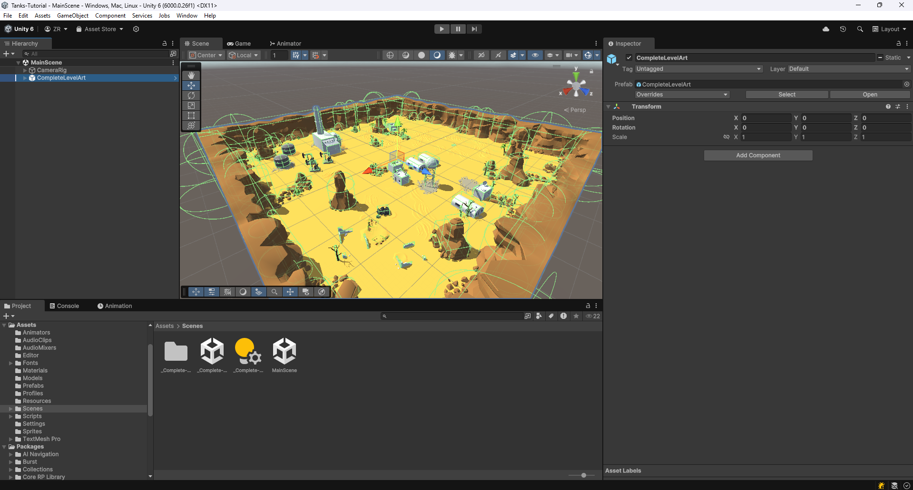
Play Buttons
Scene
Inspector
Heirarchy
Project

Slide 13
02
Tank Movement

Slide 14
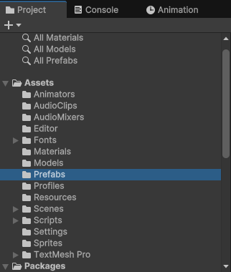
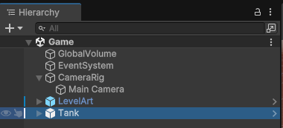
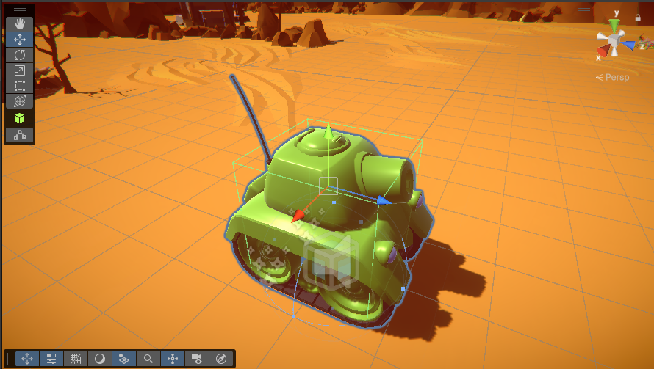
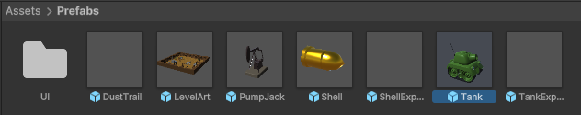
Adding A Tank To The Scene
1.
3.
4.
2.
SAVE WITH CTRL+S

Slide 15
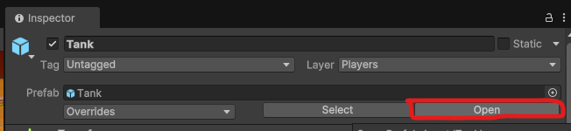

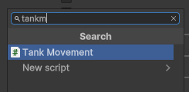
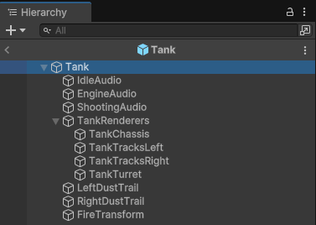
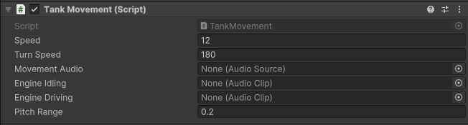
Adding The Tank Movement Script To The Tank
1.
3.
4.
2.
5.
SAVE WITH CTRL+S

Slide 16
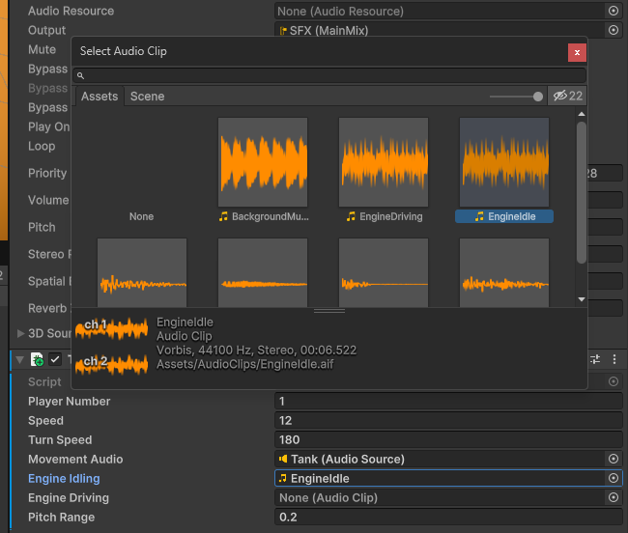
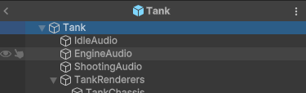
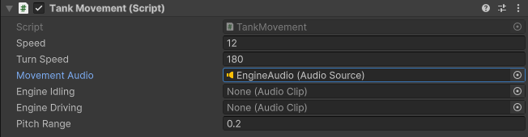
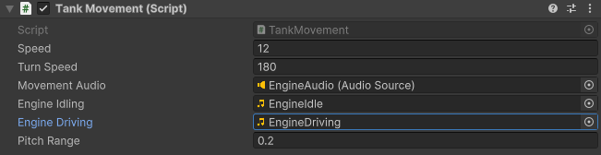
Setting The Tank Movement Script Values
3.
1.
2.
4.
SAVE WITH CTRL+S

Slide 17
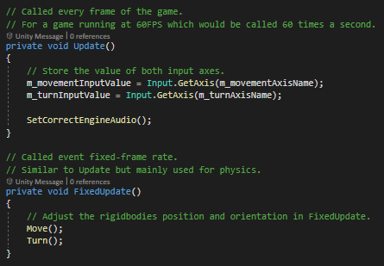
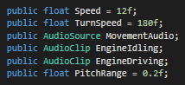
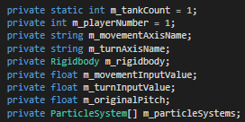
Tank Movement Script
Public values can be seen in the inspector
Private values are NOT shown in the inspector

Slide 18
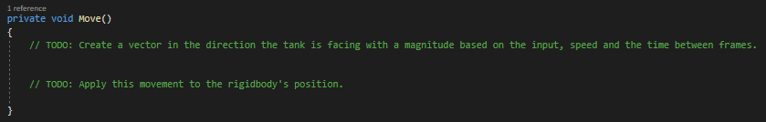
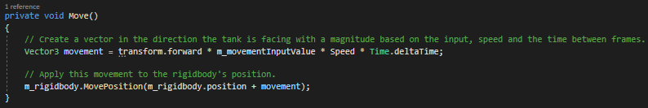
Coding Tank Movement
SAVE WITH CTRL+S

Slide 19
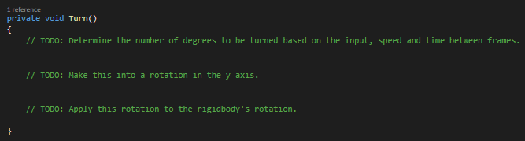
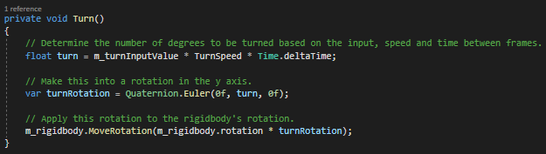
Coding Tank Turning
SAVE WITH CTRL+S

Slide 20
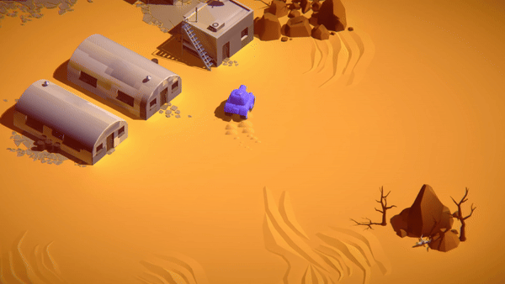
Testing Tank Movement!

Slide 21
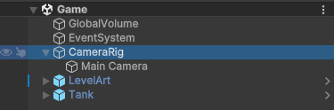
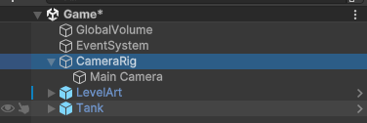
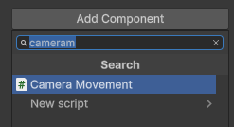
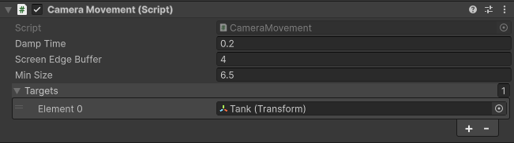
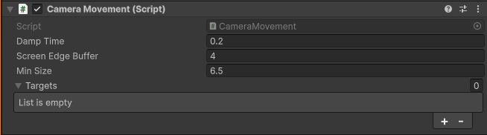
Camera Movement
1.
4.
2.
5.
3.
SAVE WITH CTRL+S

Slide 22
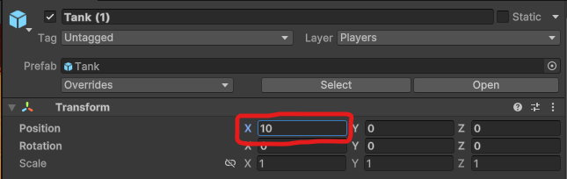
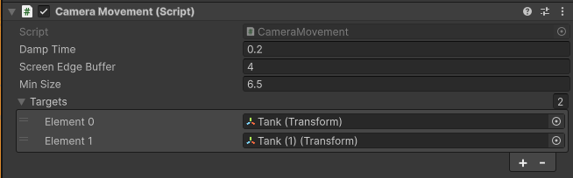
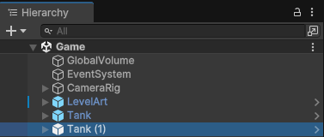
Adding Another Tank
1.
4.
5.
2.
3.
SAVE WITH CTRL+S

Slide 23
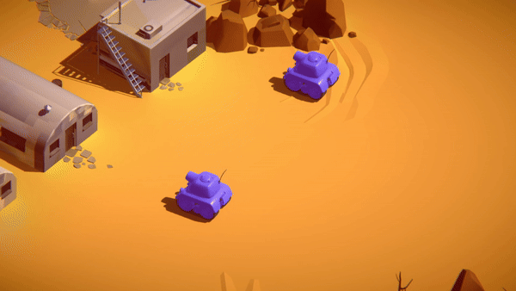
Testing Camera Movement!

Slide 24
03
Tank Shooting

Slide 25
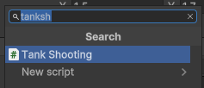
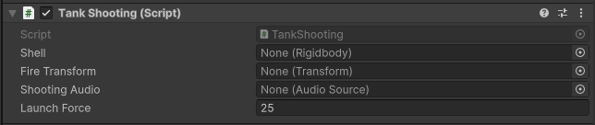
Adding The Tank Shooting Script To The Tank
1.
3.
4.
2.
5.
SAVE WITH CTRL+S

Slide 26
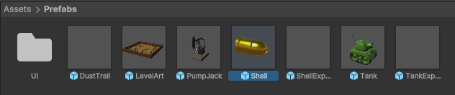
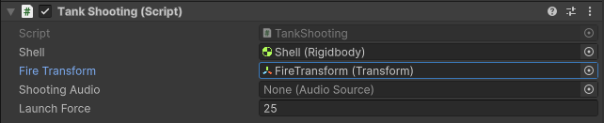
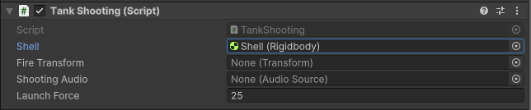
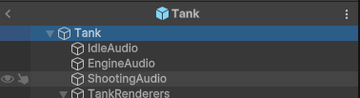
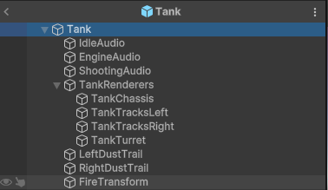
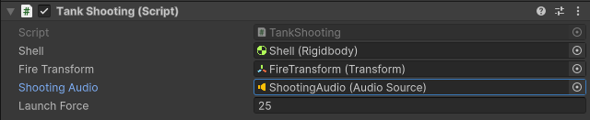
Setting The Tank Movement Script Values
1.
4.
2.
5.
3.
6.
SAVE WITH CTRL+S

Slide 27
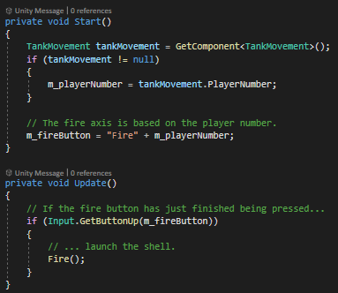
Tank Shooting Script

Slide 28
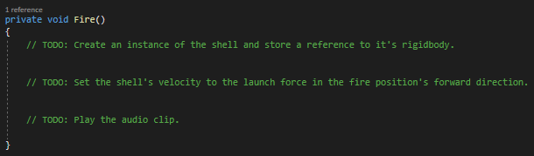
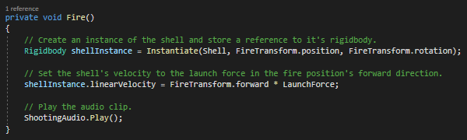
Coding Tank Shooting
SAVE WITH CTRL+S

Slide 29
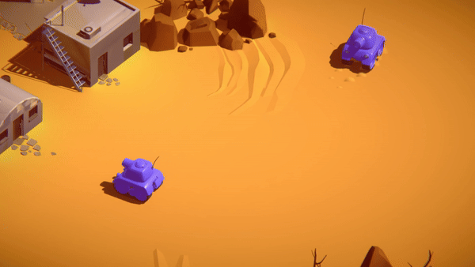
Testing Tank Shooting!

Slide 30
04
Tank Health

Slide 31
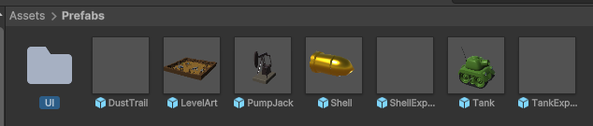
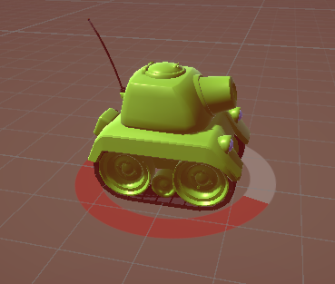
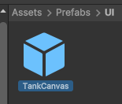
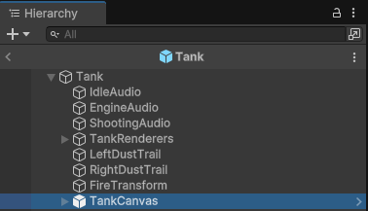
Add UI Slider To Tank
1.
4.
2.
3.
SAVE WITH CTRL+S

Slide 32



Add Tank Health Script To Tank
1.
4.
2.
3.
SAVE WITH CTRL+S

Slide 33






Setting The Tank Health Script Values
4.
1.
2.
5.
3.
6.
SAVE WITH CTRL+S

Slide 34

Tank Health Script
Most of the collision logic happens in the Shell Explosion script

Slide 35


Code Tank Health
SAVE WITH CTRL+S

Slide 36

Testing Tank Health!

